Slide 1
Developing the Python Calculator using Tkinter Library
NextHikes PROJECT 1
Name: Wasim Akram Khan
Affiliation: DigiCrome Academy

Slide 2
Introduction
This Project has been introduced on the basis of Python-based Calculator from Tkinter library with Graphical User Interface (GUI) application toolkit using Visual Studio Code.
Using the Python Calculator can simplify the complex calculations for users to increase their accuracy.
It allows the users to define the mathematical solution and save their time by providing the outcome on fingertips.
The Objective of this calculator is to provide the numerical operations and improve the efficiency without any mathematical errors.
Let’s begin. ☺

Slide 3
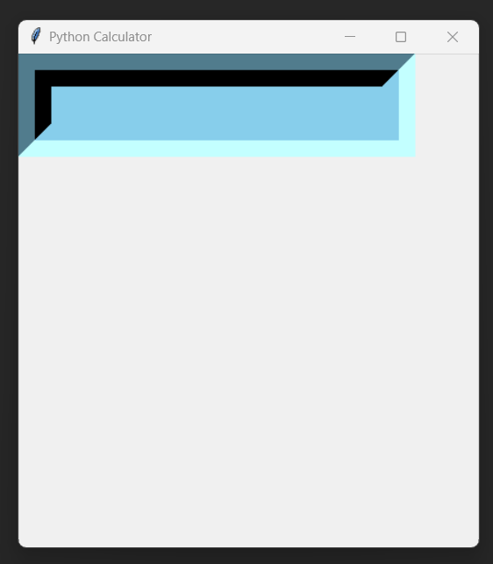
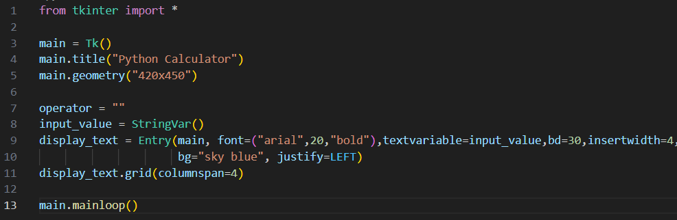
GUI Canvas Display of Python Calculator
Tkinter library has been carried out to create a calculator.
GUI Canvas Display has been created where we've assigned the title of Calculator as 'Python Calculator' after importing tkinter from library.
Function " var.mainloop() " helps us to run the app continuously, it is an infinite loop to run the calculator/program without any interruption. Below functions were used to create the Canvas with title as shown in the picture below.

Slide 4
Main Functions to design the Python Calculator
To create combine the display for each column assigned, “columnspan” function was used as shown in the previous slide.
By using "global function", we can command and execute the code for each function present within the calculator.
To pass the instruction to each button differently, we’ve defined the buttons as def buttonClick(), def buttonClear() and def buttonEqual().
We’ve passed the instruction to each buttons separately with “Button function”, with different parameters to each buttons as padx, bd, fg, font, text(variable), command, lambda and the function which was defined as def buttonClick(), def buttonClear() and def buttonEqual().
Using “ var.geometry ” function, we can fix and adjust the length and width of ‘Python Calculator’ canvas.
Additionally, we’ve also provided the parameter “ jusify=RIGHT ”, where justify is a parameter for the text passed in Display box which will start from “Right”.
“ eval function ” is to evaluate the given source in the context of globals and locals. The source may be a string representing a Python expression or a code object as returned by compile(). The globals must be a dictionary and locals can be any mapping, defaulting to the current globals and locals. If only globals is given, locals defaults to it.

Slide 5
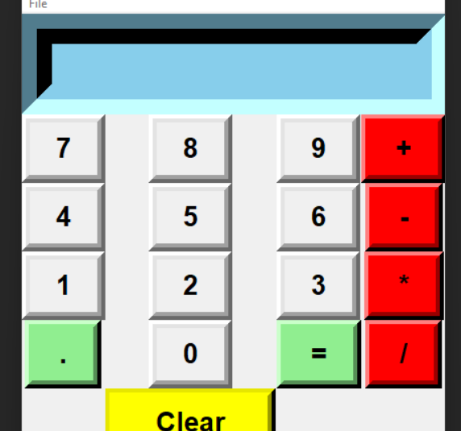
Parameters used in Python calc are:
padx = padx used to manage the size of pad (each buttons present)
bd = bd is used for border
fg = fg is used for foreground
bg = bg is used for background
font= font is used to change the font style, size and type
command = to command the buttons as defined
row = row is to assign the row for each buttons
column = to assign the column for each buttons
menu = menu is to create the filemenu on top head with dropdown lists.
label = label parameter is to label the filemenu dropdowns.

Slide 6
Summarization of this project
After reviewing this project, you must be already aware that this project aims to solve the mathematical problems and deliver the efficiency to the users.
The functionality and key feature of this project has been introduced during the journey of this presentation, along with visuals, screenshots, tools and the methodologies used in this calculator.
In a nutshell, the users can operate this tool with the aim to achieve a desired outcome without any error being occurred.
I highly appreciate your kind attention to this project and delighted to be a part of this project which helped in enhancing the relevant knowledge around Python. Looking forward to work on more projects and to have a positive impact on my learning.

Slide 7
Thank you
GITHUB: Wasim8700692354

